Slide 1
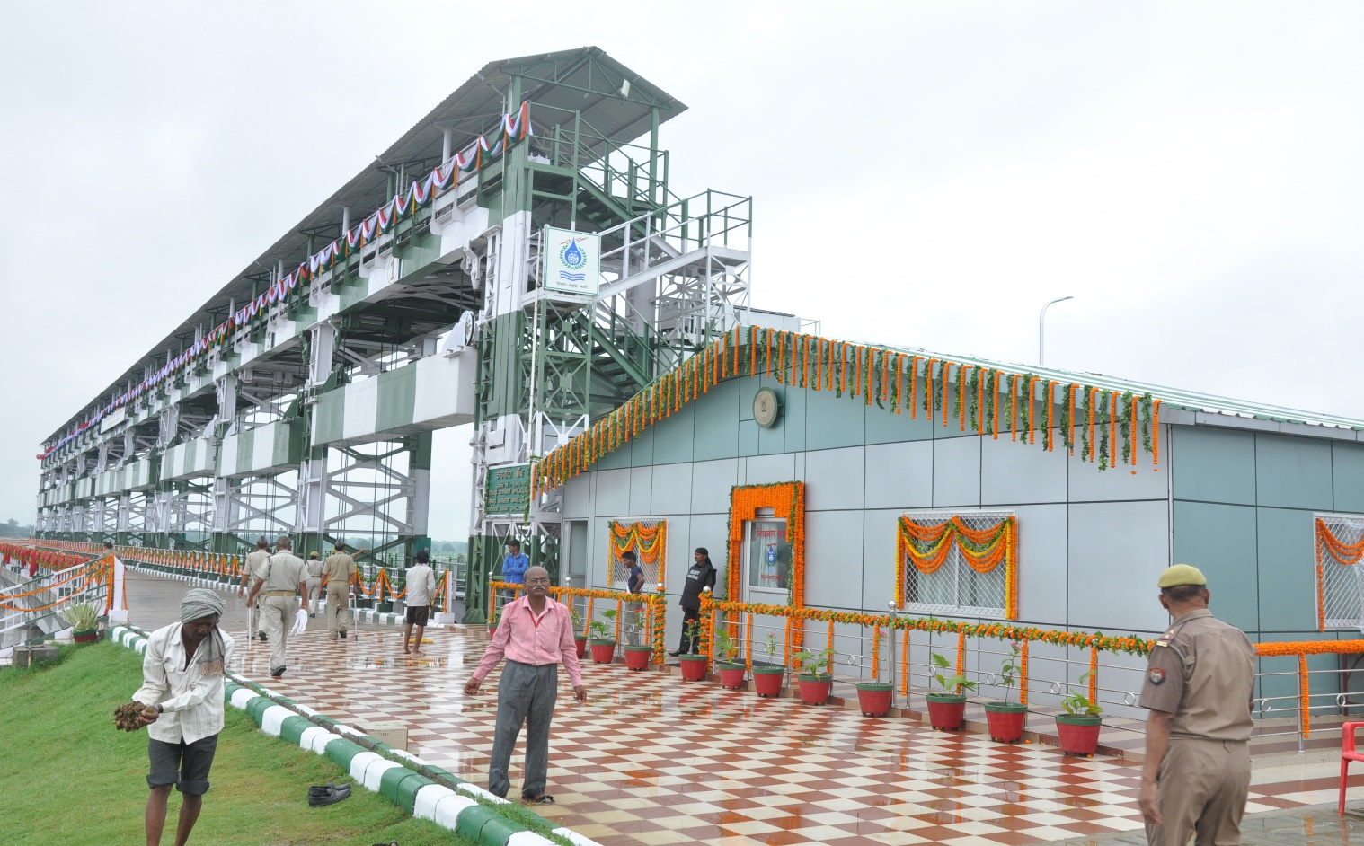
Irrigation Department, Uttar Pradesh
Automation of Dams/Barrages in U.P. with the help of SCADA System
Presented By
Mr. Navin Kapoor, Superintending Engineer
Dated: 08.11.2016

Slide 2
Irrigation Scenario in U.P.
Uttar Pradesh is India’s most populated state and area wise fourth largest state, situated between 23°52’N - 31°28’N latitudes and 77°3’E- 33°39’E longitude.
U.P. has 8 large Perennial river basins covering the geographical area of 3.41 lac Sq. Km.
U.P. has a largest infrastructure of Irrigation system in country.
The Irrigation facility in the state is provided with the help of 73997 Km. canals, 21 nos. Barrages, 135 Dams & Reservoirs and 33375 State Tubewells

Slide 3
Irrigation Scenario in U.P.
The economy of Uttar Pradesh is agriculture dominated.
Geographic area of U.P. is 24.093 million hectares
Approximately 80% of total geographical area is agriculture land.
Agriculture sector contributes about 40% of state GDP and 75% of employment.
70% of Agriculture is dependent on irrigation.
Due to variations in rainfall, some part suffer from flood and some from draught each year.
It is estimated that approx. 43 lac ha. has been affected by flood every year and in worse year it increases to 73 lac ha.

Slide 4
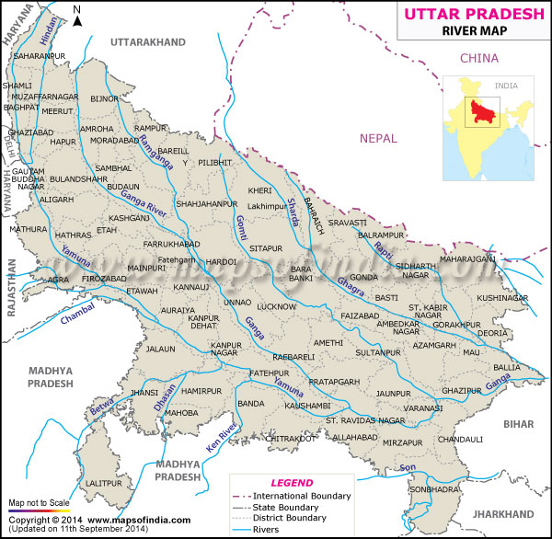
RIVER BASINS OF UTTAR PRADESH

Slide 5
Crop Water Efficiency
Required Water depth ActualWater depth
Low Crop Use Efficiency has pushed us for proper management of our irrigation infrastructure such as Barrages, Dams and Canal System, to meet the future demand due to expected population growth.
So the solution is Automation of Barrages/Dams and Canals.
* Source of data from Agriculture department, U.P.
Crop Water use Efficiency =
X 100
Category | Crops | Required Water depth (mm) | ActualWater depth (mm) excluding god rain | Crop Water Use Efficiency
Kharif | Paddy | 300-450 | 1200 | ̴25%
Rabi | Wheat | 150-200 | 700 | ̴25%

Slide 6
Main Purpose of Dam/Barrage Automation
Regular running of all the Gates from one point (control room) to prevent it from mechanical chocking of gates.
Avoiding Shoal formation in upstream of Barrage/Dam.
Acquisition of Real time data.
Through Automation we can increase efficiency of water distribution system and management to avoid run off from gates.
Manual mistakes and errors may be eliminated for calculation of discharge.
A data base will be created so we can take better decision by analyzing the data.
Using security system to prevent unauthorized entry.
Surveillance of Barrage/Dam considering its safety.

Slide 7
Benefits of Automation
Using data base, Reliable Decision Support System will be improved.
Quick decision will be taken and executed immediately without loss of time.
Improved water management by getting accurate data of Dam/Barrages and its subsidiary canals.
Improve efficiency of Irrigation.
Better Flood control management.
Accurate, consistent and reliable measurement of water level, discharge, current and other Data.
Elimination of Human error.
Reduction of manpower
Gates can be operated from control room, HMI, individually from gate(electrically and manually) and Command Centre Lucknow (if required)

Slide 8
Basic Of Automation
To make a Dam/Barrage automatic following system/Equipments
are required.
For SCADA(Supervisory Control And Data Acquisition) system, we need to have PLC(Programmable Logic Controller) at local control room, RTUs (Remote Terminal Unit) at Gates & Sensors and HMI(Human Machine Interface).
For measuring gate position, we need to have Gate Position Measuring System (Encoders).
Radar based Pond level Sensor (all to-be Locally solar powered & data transfer through Radio frequency) of distant canals.
OFC(Optical Fiber Cable), Ethernet, RJ-45, and RF(Radio Frequency) are used for communication.
VFD(Variable Frequency Drive) Starters to run the motors.
AWS(Automatic Weather Station).
Telemetry :- Broadband/ Wi-max, V-sat(redundancy)
Power (2 DG sets, Solar Power Backup for 24x7 and grid)
Camera Surveillance by IP bullet and PTZ cameras.
Acoustic Doppler Current Profiler (ADCP).

Slide 9
Our Completed projects
Lahchura Dam in distt. Jhansi (U.P.) - 22 Gates (State Funded)-17 Gates of Dams and 4 of Canals
Kachnaudha Dam in distt. Lalitpur (U.P.) - 11 Gates (State Funded) -9Gates of Dams and 2 of Canals.
HIS of Rohini Dam in distt. Lalitpur (U.P.)– 3 Gates (WB Funded)
HIS of Jamini Dam in distt. Lalitpur (U.P.) - 4 Gates (WB Funded)
HIS of Sajnam Dam in distt. Lalitpur (U.P.) – 5 Gates (WB Funded)
Our Running projects
Bhimgoda Barrage, Haridwar Dam, Upper Ganga Link canal and Eastern Ganga Link Canal in distt. Haridwar (Uttarakhand) – 49 Gates (State Funded)
Narora Barrage in distt. Bulandsahar (U.P.) – 61Gates (WB Funded-UPWSRP-II)

Slide 10
Upcoming projects
Okhla Barrage (New Delhi) - 36 Gates (NHP)
Ch. Charan Singh Madhya Ganga Barrage, Bijnor (U.P.) - 35 Gates (NHP)
Hindon Barrage, Gaziabad (U.P.) – 12 Gates (NHP)
Ram Ganga Dam (Uttarakhand) – 8 Gates (State Funded)
Afjal Garh Dam (Uttarakhand) – 4 Gates (State Funded)
Maudaha Dam, Hamirpur (U.P.) – 11 Gates (State Funded)
Harevli Barrage, Dhampur (U.P.) – 25 Gates (State Funded)
Kho Barrage, Dhampur (U.P.) – 23 Gates (State Funded)

Slide 11
Lahchura dam in distt. Jhansi (U.P.)
Lahchura dam Spill way Gate size 18.00 M x 7.60 M - 17 no.
Dhasan Head Regulator Gate size 8.00 M x 3.85 M - 01 no.
Arjun Sahayak Head Regulator Gate size 12.00 M x 2.86 M - 03 no.
total No. of Gate = 21.
Details of Automation Work:-
Complete Electrification, Automation with SCADA with redundancy.
VFD (Variable Frequency Drive) starters for motor.
Current value of all motors also displayed.
for security purpose Alarm Hooter &
Lightening Arrester installed over Control room.
Installation of IP & PTZ cameras
Solar Powered RF (radio Frequency) Radar based Pond Level Sensor are used.
V-Sat and Broadband for Data Transmission
Automatic Weather Station with IP data Logger
Solar Power Backup of 8 KW.
OFC looping and RJ-45 cables are used for communication, considering redundancy.

Slide 12
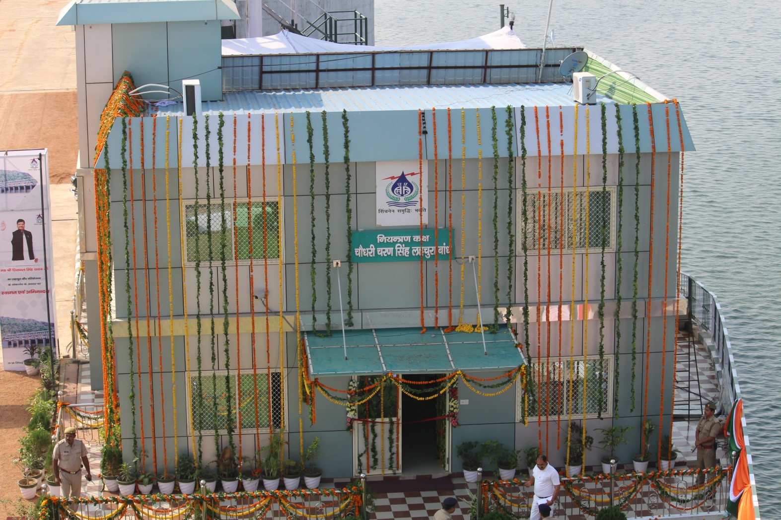
Lahchura dam in distt. Jhansi (U.P.)
Control Room
Down stream Side

Slide 13
Lahchura dam in distt. Jhansi (U.P.)
Line Diagram of Electrical & automation work

Slide 14
Lahchura dam in distt. Jhansi (U.P.)
Lahchura dam gate opening with discharge
Arjun Sahayak gate
opening with discharge
Dhasan gate opening
with discharge
DG set On/Off
Gate position
Live video of PTZ camera
we get all real time data (all water levels, discharge, total capacity of dam, all gate positions, rain and weather station data) in a single screen
All gate of dam and canals can be operated, gate position & discharge is indicated bellow each gate tab.
Instant discharge with respect to gate position and pond level.
DG set gives current & voltage Data.
When we give command to open gate first Hooter will start for 30 seconds(to warn the people) after that gate will move.

Slide 15
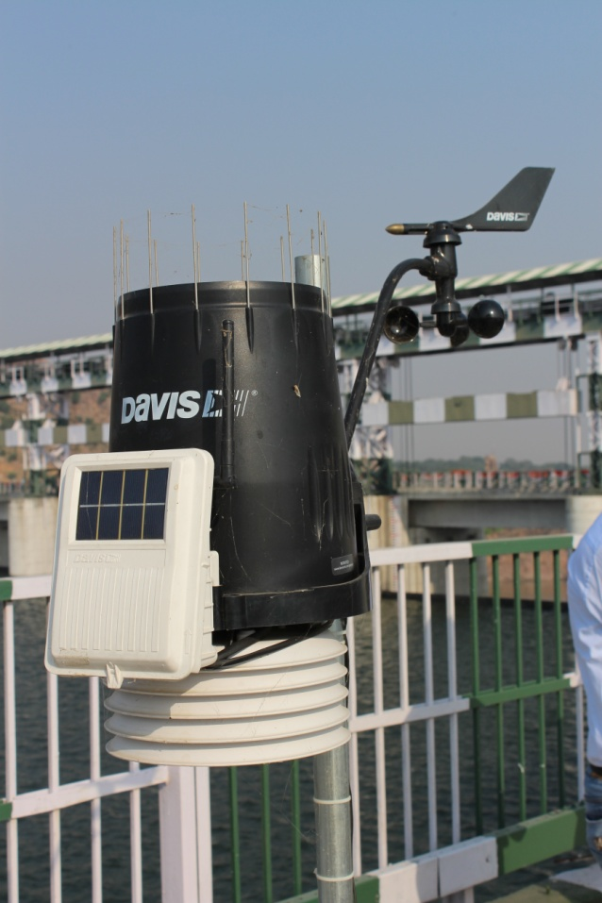
Lahchura dam in distt. Jhansi (U.P.)
Solar Panels
Automatic Weather Station (AWS)
V - Sat

Slide 16
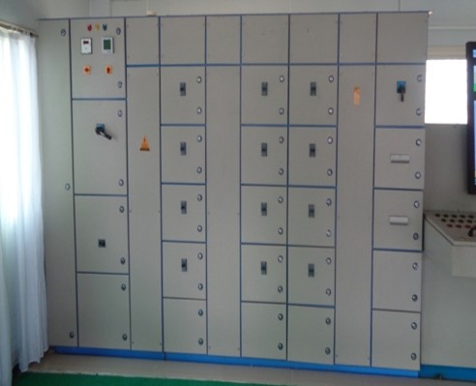
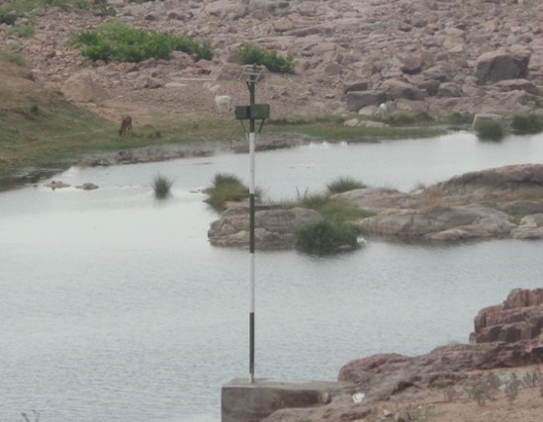
Lahchura dam in distt. Jhansi (U.P.)
PTZ Camera
Electrical Panel
Pond level sensor
Pond level sensor with RF

Slide 17
Lahchura dam in distt. Jhansi (U.P.)
Arjun Sahayak Head Regulator
Dhasan Head Regulator

Slide 18
Kachnauda dam in distt. Lalitpur (U.P.)
Kachnaudha dam Spill way Gate size 12.00 M x 7.24 M - 09 no.
Under sluice Gate size 1.00 M x 1.50M - 02 no.
Canal Gate size 1.5 M x2.00 M - 02 no.
Stop log Gate size 12.00 M x 8 M - 01 no.
Details of Automation Work:-
Complete Electrification, Automation with SCADA with redundancy.
Automatic Starters for motor.
Current value of all motors shown locally.
for Security purpose Alarm Hooter &
Lightening Arrester installed over Control room.
Installation of IP & PTZ cameras
Pond Level Sensor
Wi-Max and V-Sat (redundant) for Data Transmission
Digital Measurement Instrument (transducer)
Tip and bucket type Rain Gauge
Solar Power Backup.
OFC cables with looping and RJ-45 cables are used for communication.

Slide 19
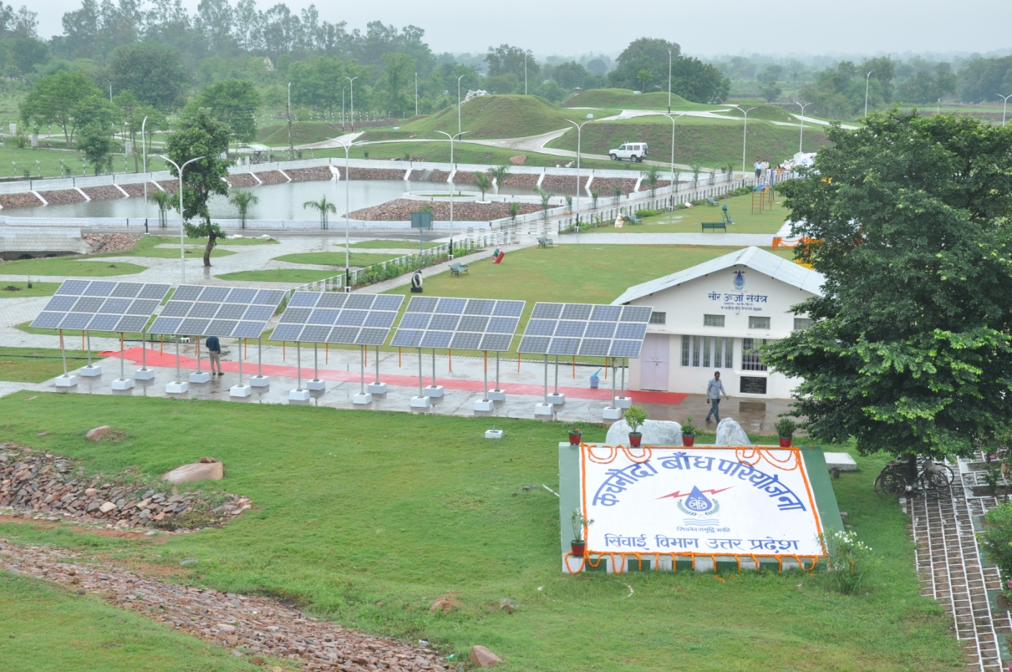
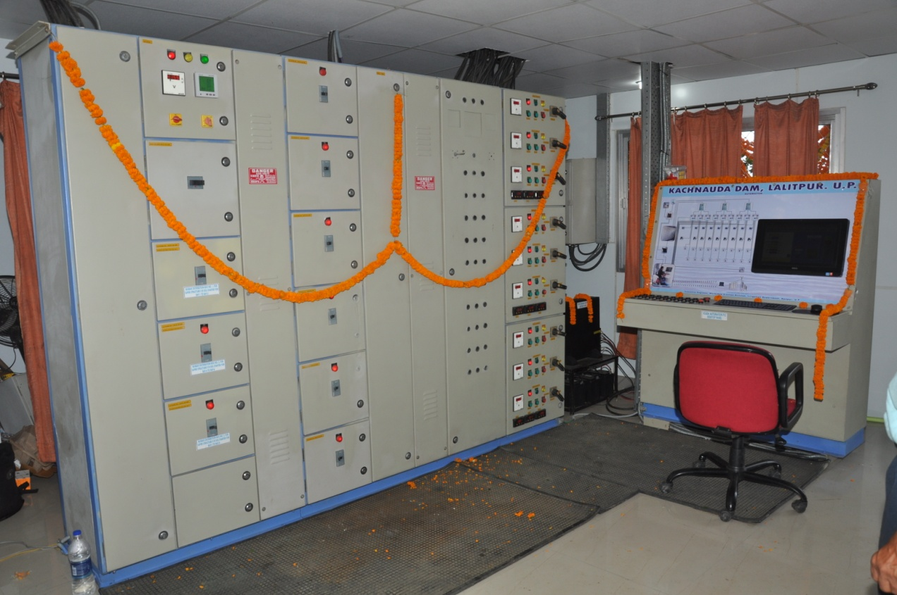
Solar Powerd Electrification of Kachnaudha Dam
Electrical Panel with Automation (SCADA) Panel

Slide 20
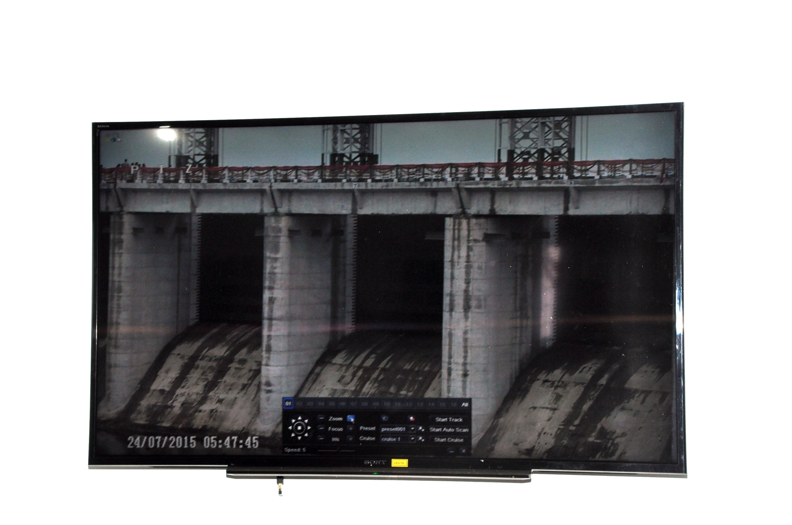
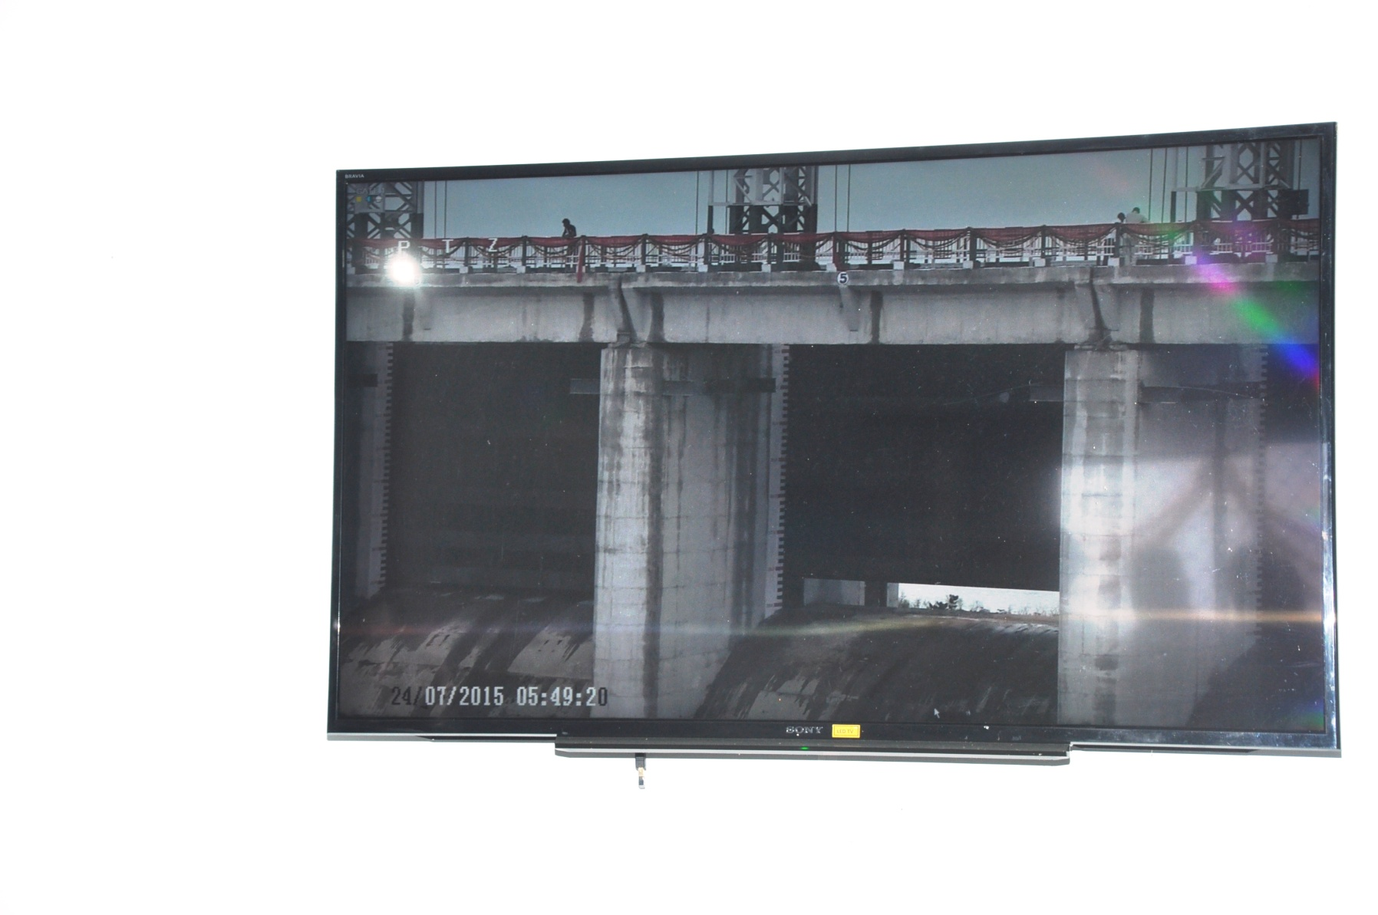
Kachnaudha Dam Viewed by PTZ camera all gates are closed
Kachnaudha Dam Viewed by PTZ camera middle gates is opening

Slide 21
Haridwar Dam, Upper Ganga Link Canal Head Regulators, Eastern Ganga Canal Head Regulators & Bhim Goda Barrage at Haridwar (Uttarakhand)
Haridwar Dam - 10.00 X2.30 M = 15 Nos
Upper Ganga Link Canal H. R. 11.00 X3.05 M = 08 Nos
Eastern Ganga Canal H. R 11.00 X3.05 M = 04 Nos
Bhim Goda Barrage - 18.00 X 8.40 M =07 Nos
Under sluice Gate 18.00 X 7.80 M =15 Nos
total No. of Gate = 49.
Details of Automation Work:-
Complete solar powered Electrification , Automation with SCADA with redundancy..
HMI(Human Machine Interface) panel installed over the super structure by which we can operate the gates.
VFD (Variable Frequency Drive) starters for motor.
Current value of all motors,
for Security purpose Alarm Hooter &
Lightening Arrester installed over Control room.
Installation of IP & PTZ cameras
Solar Powered RF transmission Radar based Pond Level Sensors in upstream of Barrage.
Solar Powered GSM transmission Pond Level Sensors in Canals up-to 12 Kms.
Broad band and V-Sat (redundant) for Data Transmission
Automatic Weather station comprising with Tip and bucket type Rain Gauge.
Solar Power Backup of 20 KW.
Redundancy is insured with looping and also in communication from control room to RTUs and other instruments.
RF is used for communication between Main Control room to Haridwar dam (because it is 1.5 Km far).
Canal automation of Upper Ganga Link Canal at Haridwar upto 12 km down stream by installing Radar based Pond level Sensor equipped with Locally Solar powered and data transfer through GSM.

Slide 22
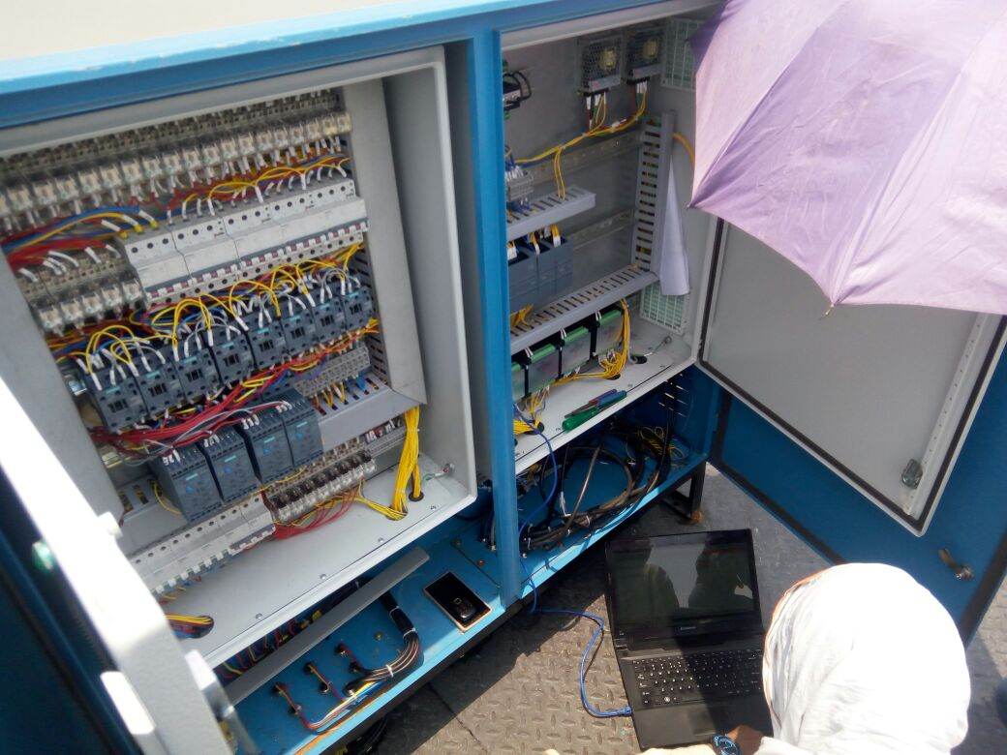
Haridwar Dam, Upper Ganga Link Canal Head Regulators, Eastern Ganga Canal Head Regulators & Bhim Goda Barrage at Haridwar (Uttarakhand)
RTU Panel

Slide 23
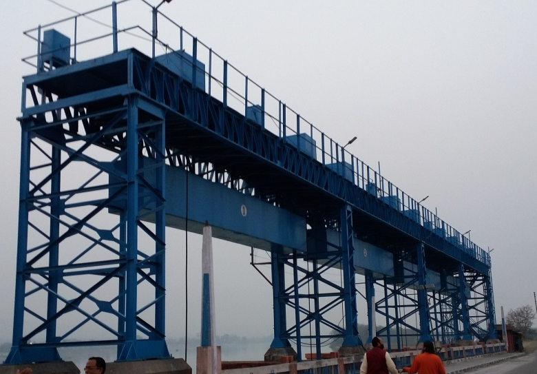
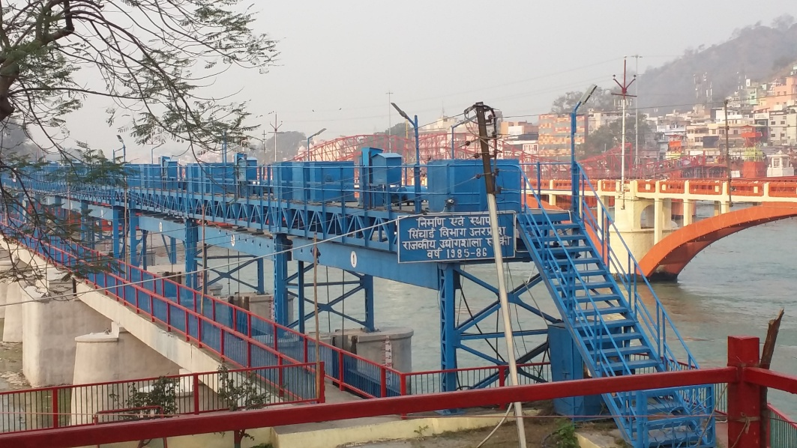
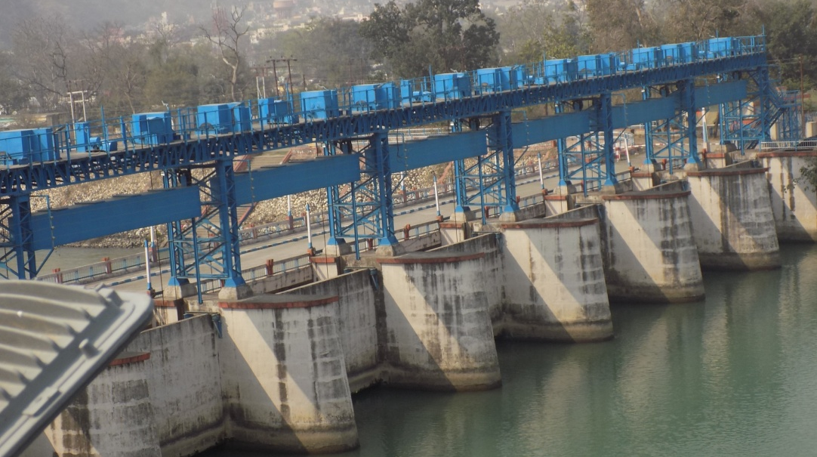
EASTERN GANGA
CANAL H.R.
BHIM GODA BARRAGE
UPPER GANGA CANAL H.R.
HARIDWAR DAM
UPPER GANGA CANAL H.R.

Slide 24
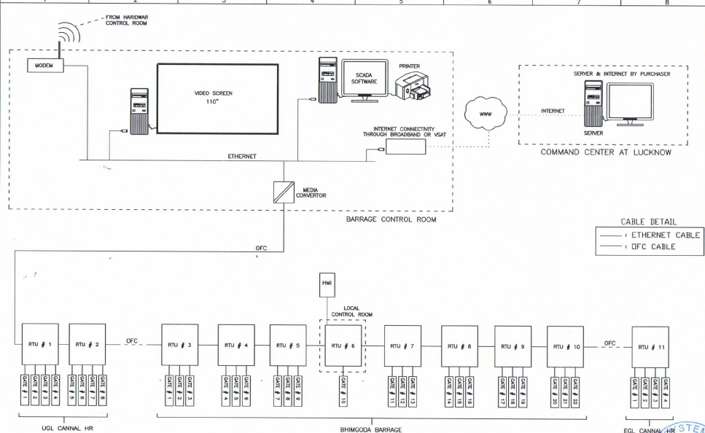
Haridwar Dam, Upper Ganga Link Canal Head Regulators, Eastern Ganga Canal Head Regulators & Bhim Goda Barrage at Haridwar (Uttarakhand)
Schematic Diagram of RTU

Slide 25
Ch. Charan Singh Ganga Barrage Narora in distt. Bulandshahar (U.P.)
Narora Barrage (U/S)- 15.24 X4.75 M = 07 Nos
Narora Barrage (other bay) 12.20 X3.23 M = 54 Nos
total No. of Gate = 61.
Details of Automation Work:-
Complete solar powered Electrification , Automation with SCADA with redundancy.
First time Silt Level Transducers installed
First time Real time surveillance of under water surroundings of Barrage 24x7 by using Under Water Cameras.
HMI(Human Machine Interface) panel installed over the super structure by which we can operate the gates.
Soft Starters for motor.
Current value of all motors also displayed by which we can eliminates the burning of motor and find out the faults.
for security purpose Alarm Hooter & Lightening Arrester installed in Control room.
Installation of IP & PTZ cameras
Solar Powered RF (radio Frequency) transmission Radar based Pond Level Sensor are used.
Broad band and V-Sat (redundant) for Data Transmission
Tip and bucket type Rain Gauge.
Solar Power Backup of 20 KW.
2 DG Sets
Solar powered RTUs .
OFC and Ethernet cables is used for communication from control room to RTUs and other instruments.

Slide 26
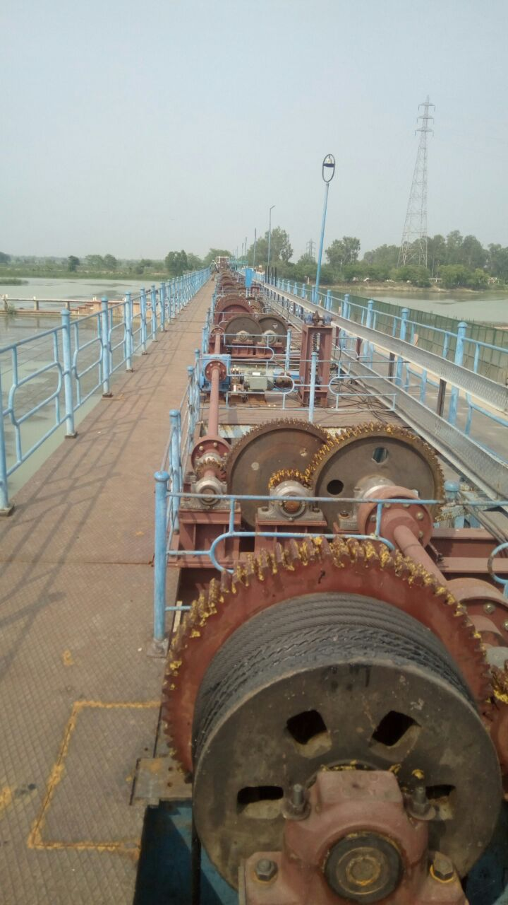
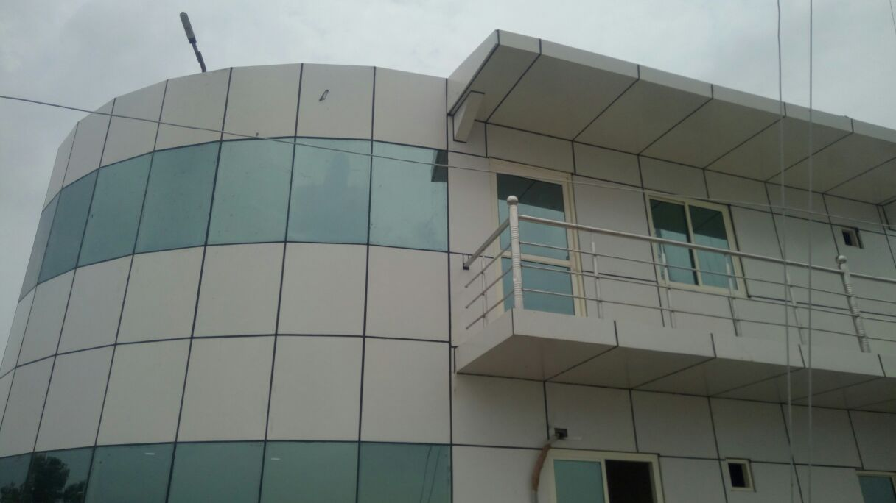
Ch. Charan Singh Ganga Barrage Narora in distt. Bulandshahar (U.P.)
Control Room
Electrifying the Barrage from manual to electrical
Solar power RTU
Radar Based pond level sensor

Slide 27
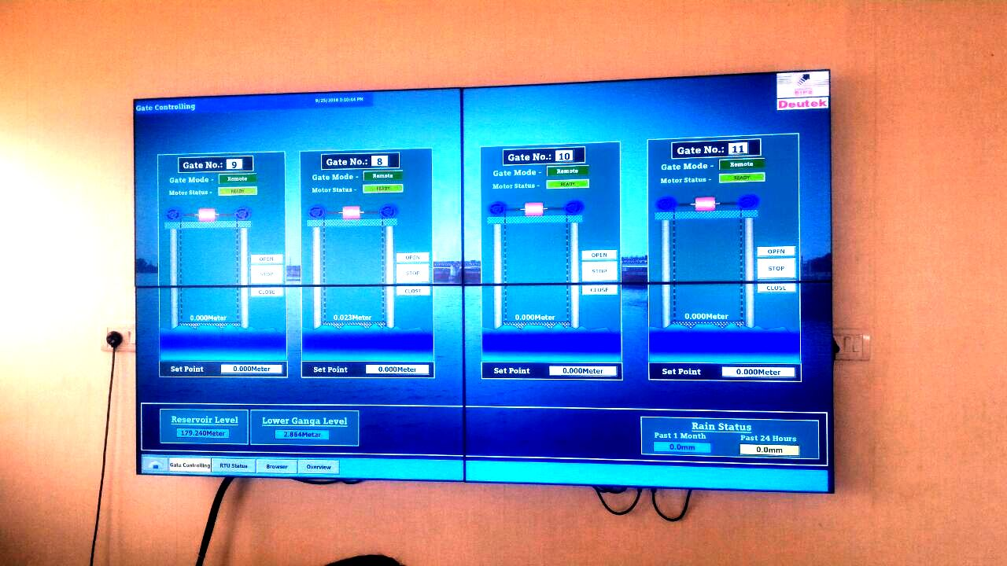
Ch. Charan Singh Ganga Barrage Narora in distt. Bulandshahar (U.P.)
Reservoir level
Rain Data

Slide 28
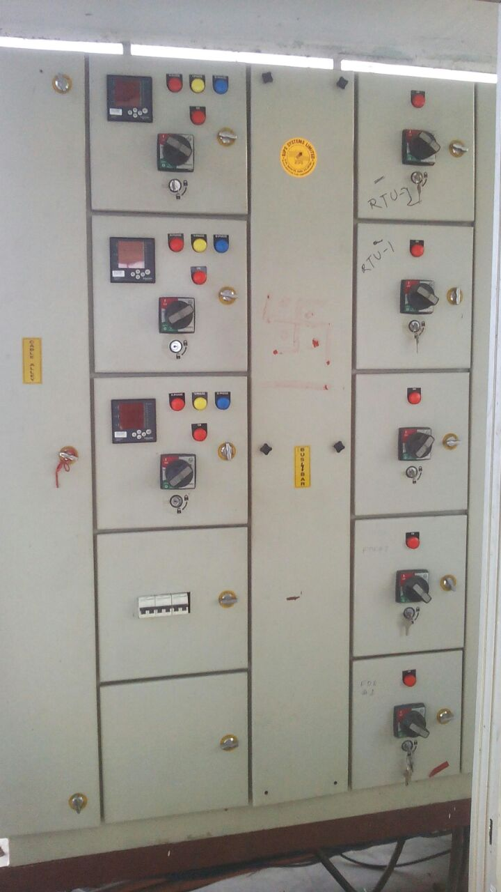
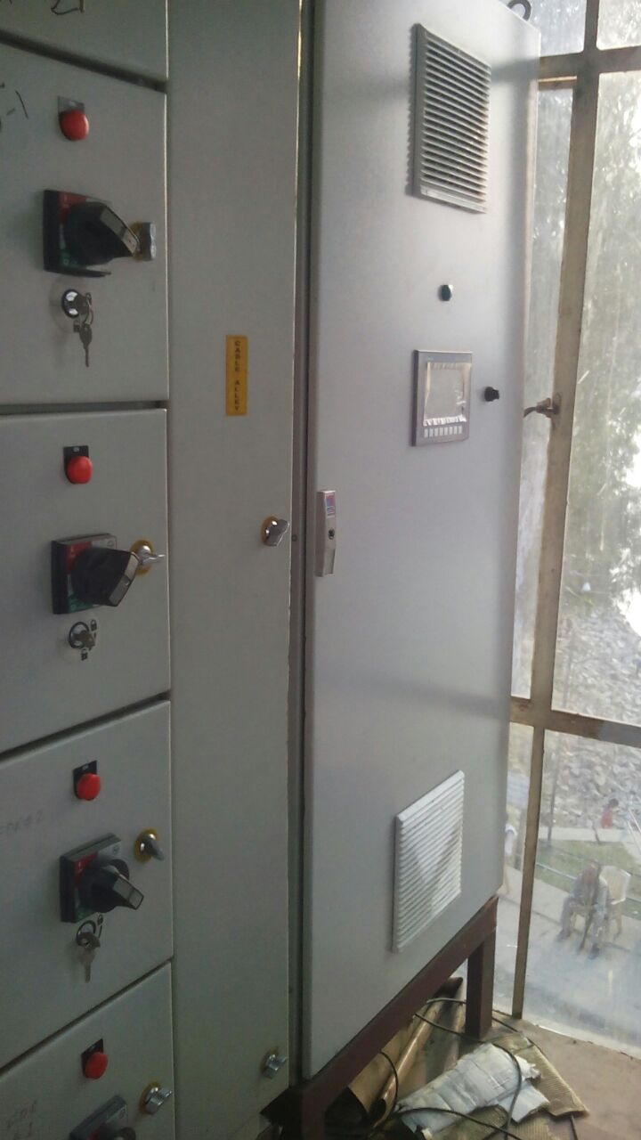
Ch. Charan Singh Ganga Barrage Narora in distt. Bulandshahar (U.P.)
HMI(Human Machine Interface) panel installed over the super structure by which we can operate the gates.
Electrical Panel
HMI Panel

Slide 29
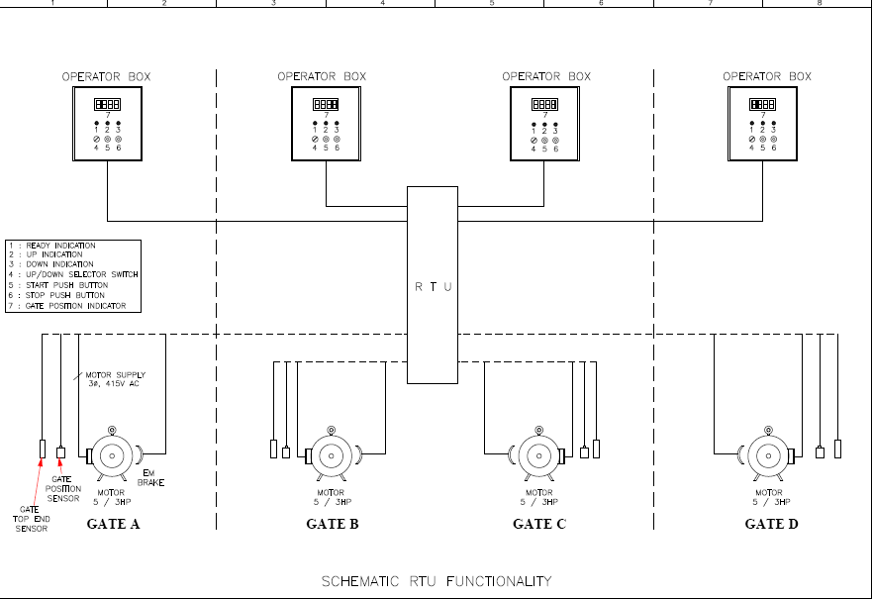
Ch. Charan Singh Ganga Barrage Narora in distt. Bulandshahar (U.P.)
Schematic Diagram of RTU

Slide 30
Okhla Barrage, New Delhi
Okhla Barrage (U/S)- 8.00 M x 6.00 M = 05 Nos
Okhla Barrage (other bay) 18.00M x 5.10 M = 22 Nos
Agra Canal, Head Regulator 7.80 M x 3.15 M = 09 Nos
Total Nos. of Gate= 36.
Details of Automation Work will be performed:-
Complete solar powered Electrification , Automation with SCADA with redundancy..
HMI(Human Machine Interface) panel installed over the super structure by which we can operate the gates.
VFD (Variable Frequency Drive) starters for motor.
Current value of all motors also displayed by which we can eliminates the burning of motor and find out the faults.
for operation & security purpose Alarm Hooter & Lightening Arrester installed.
Installation of IP & PTZ cameras
Solar Powered RF (radio Frequency) Radar based Pond Level Sensor are used.
Broad band and V-Sat (redundant) for Data Transmission.
Tip and bucket type Rain Gauge.
Solar Power Backup 24x7.
OFC cables with looping is used for communication from control room to RTUs and other
First time Flood Alarm System will be used at 5 km upstream side.

Slide 31
Okhla Barrage, New Delhi
Schematic Diagram of RTU

Slide 32
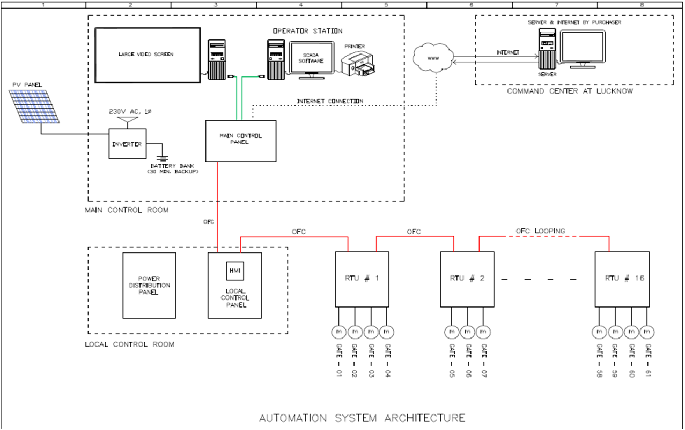
Automation System Architecture

Slide 33
Features of Automation & SCADA System
System has Redundancy.
Protection IP 65 is used to all instruments.
Automatic Control through ARMAC(Automatic Reservoir Monitoring And Control ) software.
Solar powered automation with 24X7 backup (all automation instruments, control room and street lights).
Radar based Pond level Sensor equipped with Locally Solar powered and data transfer through Radio frequency are used due to non accessibility through cable.
2 DG sets considering redudancy and grid supply for operation of gates.
Each RTU is designed for maximum 4 gates.
Validation of discharge data through ADCP once in every 2 months so that we can ensure the accuracy of instruments.
OFC looping.

Slide 34
Features of Automation & SCADA System
Gates can be operated from Local control room, HMI, individually from gate(electrically and manually) and Command Centre Lucknow (if required)
Each encoder equipped with local display showing gate position.
Current value of all motors also displayed by which we can avoid burning of motors and find out the faults.
For operation & security purpose Alarm Hooter. &
Lightening Arrester installed over Control room and also at the ends of Barrage/Dam.
Real time surveillance of Barrage/Dams and its surroundings 24x7 by IP & PTZ cameras(can also be viewed by mobile phone) are installed.
Automatic Weather Station with IP data Logger storing data for 5 years.

Slide 35
Special work which are introduced First time to our Dam/Barrages
Canal automation of Upper Ganga Link Canal at Haridwar upto 12 km down stream by installing Radar based Pond level Sensor equipped with Locally Solar powered and data transfer through GSM.
Silt Level Transducers is installed at Narora Barrage first time not it will be used at Okhla also.
First time Real time surveillance of under water surroundings of Barrage 24x7 by using Under Water Cameras at Narora Barrage, Narora.
Laser Based Limit Switches for gate operation at Bhimgauda Barrage.

Slide 36
System Technical Specifications
Controller for Gate control
High speed CPU with min. 90 micro sec/ 1000 bit instruction with sufficient memory
CPU has min. 8 digital input and 4 digital output and capable to handle min 2000 I/Os.
CPU have RS 232 & RS485 ports, PWM output, 2 incremental encoders etc.
Programming software confirms to IEC61131-3 standards.
Master Controller for Dam/Barrage Control Room
Have sufficient memory
High speed CPU with min. 7 micro sec/ 1000 bit instruction
CPU can handle min 1892 I/Os.
have RS 232 port.
Programming software confirms to IEC61131-3 standards.
HMI for local display
3.5”, 24 V DC touch screen color display, N play type
Display VFD, gate control and sensor parameters.
Digital Input & output module
I/O module shall be 2, 4, 8, 16, 32 channel density
Analog Input & output module
I/O module shall be 1, 2, 4, 8 s channel density supporting shielded connection method of 2 wire.

Slide 37
System Technical Specifications
Communication Controller for Remote communication
Have sufficient memory to store the data
High speed CPU with min. 90 micro sec/ 1000 bit instruction
CPU have min. 16 digital input and 4 digital output and handle min 4096 I/Os.
CPU have RS485 port, CAN bus and Profibus.
Programming software confirms to IEC61131-3 standards.
Ethernet switch (Managed)
Switch shall have switching mode of storage and forward.
Power Supply
Universal input voltage of 85 V AC to 264 V AC/ 90 VDC to 350VDC and frequency 45 Hz to 65 HZ.
Have efficiency more than 90% with MTBF of more than 500000 hr.
PLC Input/output Relay
The relay with a gold layer should be able to switch small capacities with a min. of 1mA current shall be able to switch 6A current.
confirms to IEC60664 standards.
Hardware Firewall with Integrated router

Slide 38
System Technical Specifications
SCADA
WinCC software with engineering license and runtime license.
Support creation of visualization pages.
Control coupling with OPC.
Access protection with user management.
Real-time database coupling with ODBC to MS ACCESS, MS EXCEL and SQL server.
SCADA as OPC server (DA & XL)
Networking
Redundancy function
Surge protection devices
Lightening arrester shall consist of single spark gap class I as per IEC and class B as per class VDE standard, capable of carrying 35 KA, 10/350 micro second neutral and < 1.5 KV between phase & neutral and <1.5 KV between neutral & earth.
The SPD shall be tested as per IEC 61643-21 standards.
Power and control Signal connection specifications
According to IEC 61076-2-101 and also have one capacitive PE contact to give the proper earthing to the system.
Fulfill IP65 enclosure.
Can be mounted on wall.

Slide 39
Thank You

